Slide 1
KYTC District 6 “Great Eight” Incident Management Task Force
January 7, 2015

Slide 2
Introductions

Slide 3
Approval of Minutes
10/7/14 Meeting

Slide 4
Incident Review
I-71 SB Tractor Trailer vs. Median Cable Barrier @ MM 69.3
Gallatin County

Slide 5
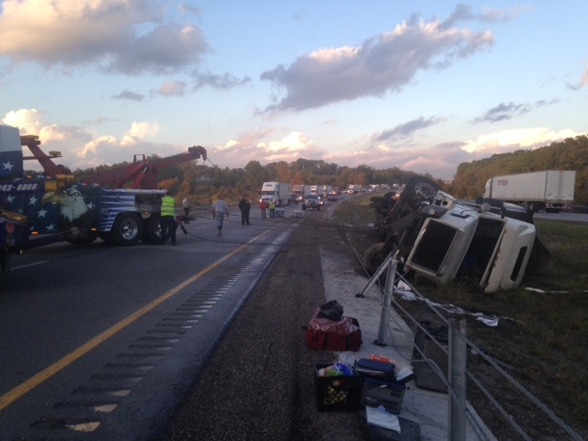

Slide 6
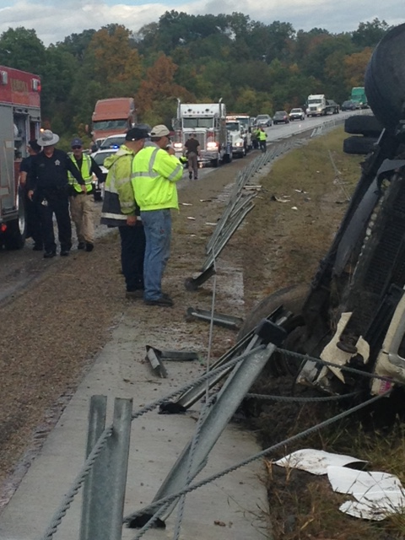

Slide 7
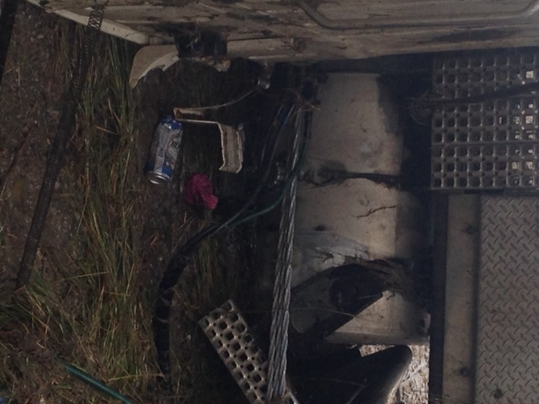

Slide 8
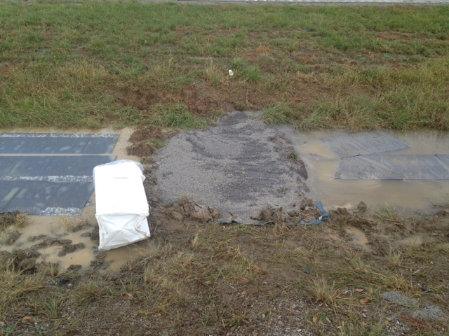

Slide 9
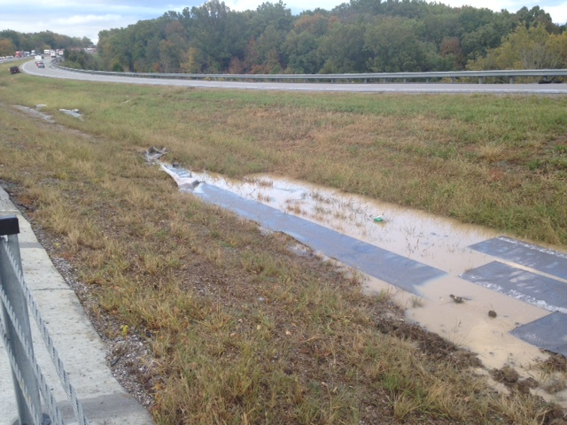

Slide 10
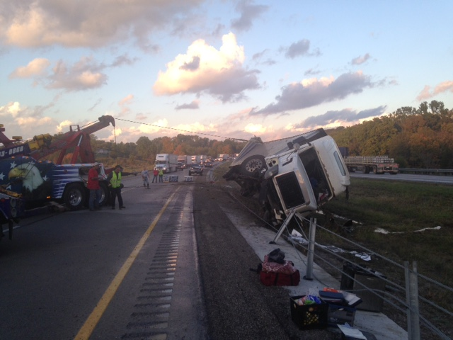

Slide 11
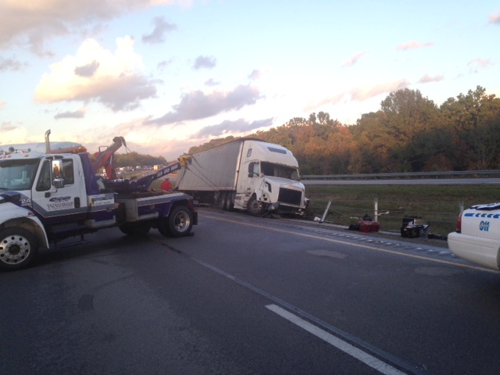

Slide 13
Incident Review
I-71 NB Lumber Truck Rollover @ MM 51
Carroll County

Slide 14
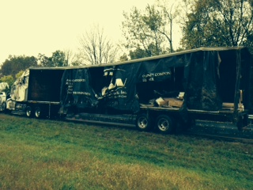

Slide 15
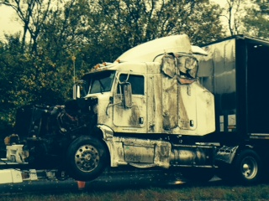

Slide 16
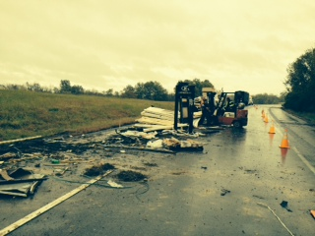

Slide 17
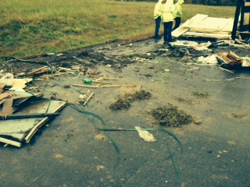

Slide 18
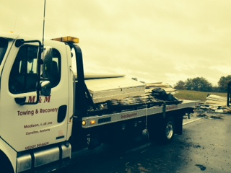

Slide 19
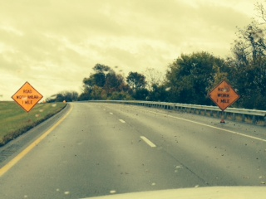

Slide 20
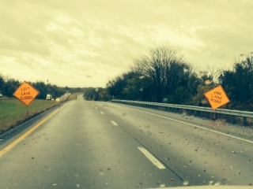

Slide 21
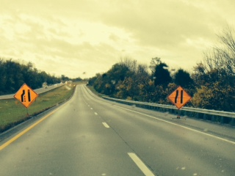

Slide 22
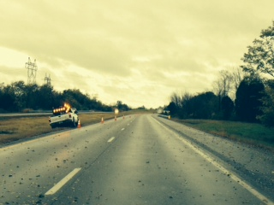

Slide 23
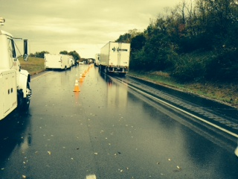

Slide 24
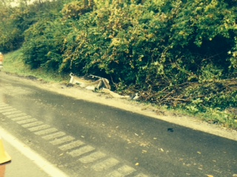

Slide 25
Incident Review
Pipeline and Hazardous Material Response Guidebook
http://phmsa.dot.gov/hazmat/library/erg

Slide 27
Crash Statistics
Quarterly Crash Statistics
KSP CRASH Database
Valerie Januski
District 6 Safety Officer

Slide 28
Southeast Counties

Slide 34
Southwest Counties

Slide 40
Yearly Crash Comparison by Route Type
Robertson County
Owen County

Slide 43
Construction Update

Slide 44
Incident Management Training

Slide 45
Other Business
Information Sharing

Slide 46
Adjourn
Next Meeting
Tuesday April 7, 2015
1:00 PM

